Slide 1
FACE DETECTION & RECOGNITION
PROJECT BY:
-EASHAN BAJAJ
-EKTA BHATIA
-AFFAN CHAROLIA
PROJECT GUIDE:
MR. VAIBHAV AMBHIRE
(ASST. PROFESSOR, COMPUTER DEPT, TSEC)

Slide 2
OUTLINE
1.FACE DETECTION
USES HAAR-LIKE FEATURES TO CLASSIFY - FACE OR NOT FACE.
2.FACE RECOGNITION
USES EIGENFACES TO CREATE SET OF IMAGES ACCORDING TO WHICH THE DATASET IS TRAINED AND TESTED. FEATURES ARE MATCHED TO RECOGNIZE THE FACE IN THE LAST STEP.

Slide 3
PROBLEM STATEMENT
DESIGN AN APP/WEBSITE WHICH WILL DETECT FACE FROM THE VIDEO, AND WILL RECOGNIZE WHOSE FACE IT IS FROM THE DATASET.
USE VARIOUS PYTHON LIBRARIES AND MACHINE LEARNING ALGORITHM TO ACHIEVE THE SAME.
TRAIN AND TEST THE DATASET TO GET THE BEST ACCURACY.

Slide 4
SCOPE
• STUDYING WHAT FACTORS ARE USED TO DETECT A FACE IN A VIDEO, AND WHAT ARE USED TO RECOGNIZE A FACE.
• HAAR CASCADE USED TO DETECT A FACE AND EIGEN FACE TO RECOGNIZE THE FACE.

Slide 5
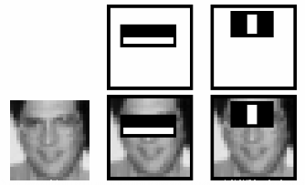
HAAR CASCADE CLASSIFIER
A HAAR CASCADE IS BASICALLY A CLASSIFIER WHICH IS USED TO DETECT THE OBJECT/FACE FOR WHICH IT HAS BEEN TRAINED FOR.

Slide 6
EIGENFACES
EVERY IMAGE IS REPRESENTED AS SOME LINEAR COMBINATION OF WEIGHTS OF EIGENFACES WHICH IS BASIS FOR ENTIRE TRAINING DATASET.
FOR RECOGNIZING WE CALCULATE THE WEIGHTS OF TEST IMAGE AND COMPARE IT WITH WEIGHTS OF ALL THE IMAGES IN TRAINING DATASET.
RECOGNIZES THE IMAGE WITH LEAST ERROR BETWEEN WEIGHTS OF TEST AND TRAINING SET.

Slide 7
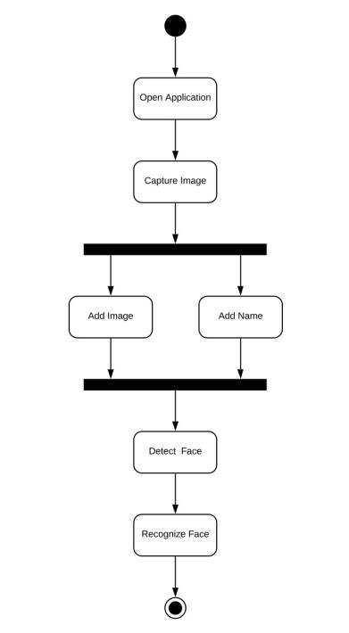
BASIC WORKING OF PROJECT

Slide 8
LITERATURE SURVEY
1.FACE DETECTION & FACE RECOGNITION USING OPEN COMPUTER VISION CLASSIFIERS.
2.IMPLEMENTATION OF FACE RECOGNITION BASED ON DEEP LEARNING FRAMEWORK CAFFE

Slide 9
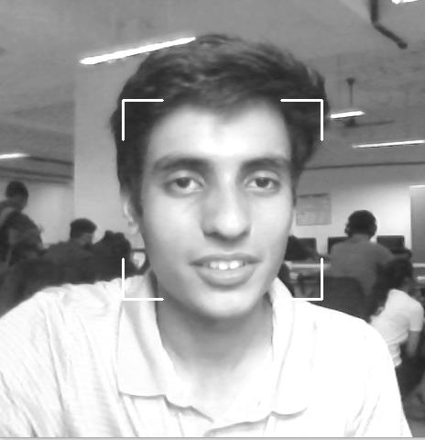
IMPLEMENTATION
STARTED OFF BY DETECTING THE FACE WHICH IS RUN USING THE HAAR-CASCADE ALGORITHM.

Slide 10
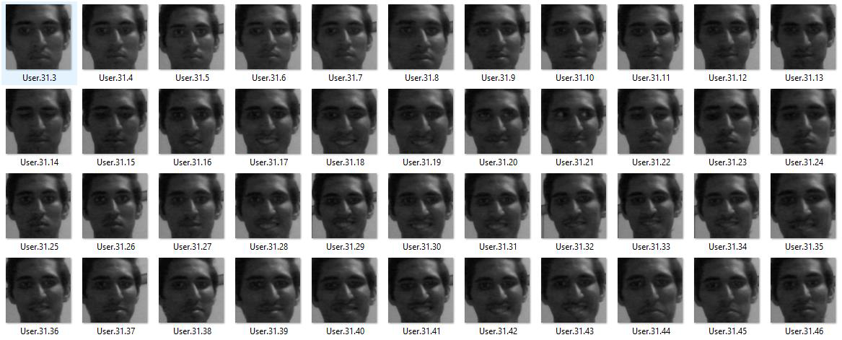
IMPLEMENTATION
ALL THE IMAGES OF THE USER ARE RECORDED AND STORED IN THE DATABASE ALONG WITH REST OF THE IMAGES.
ALL THESE IMAGES TOGETHER(DATABASE) ARE STORED IN A FOLDER.
THEN TRAINING USING THE EIGENFACE ALGORITHM TAKES PLACE.

Slide 11
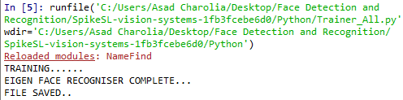
TRAINING & TESTING

Slide 12
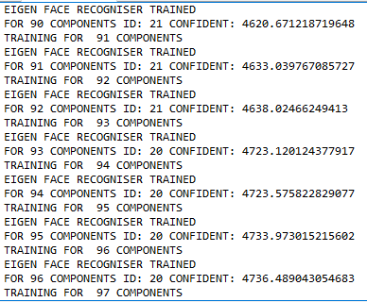
TRAINING & TESTING

Slide 13
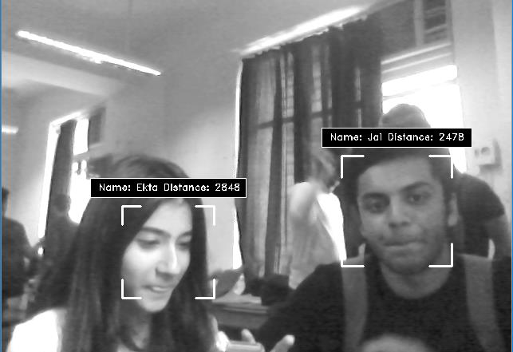
IMPLEMENTATION
IF A PARTICULAR USER FACE WAS TRAINED AND TESTED, NOW ON OPENING THE CAMERA THE FACE IS RECOGNIZED AND NAME OF THE PERSON IS DISPLAYED.

Slide 14
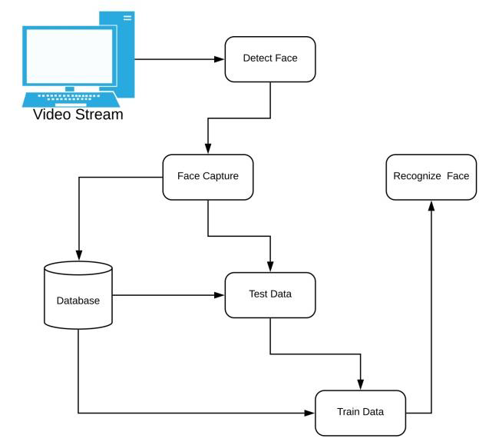
BASIC ARCHITECTURE DIAGRAM

Slide 15
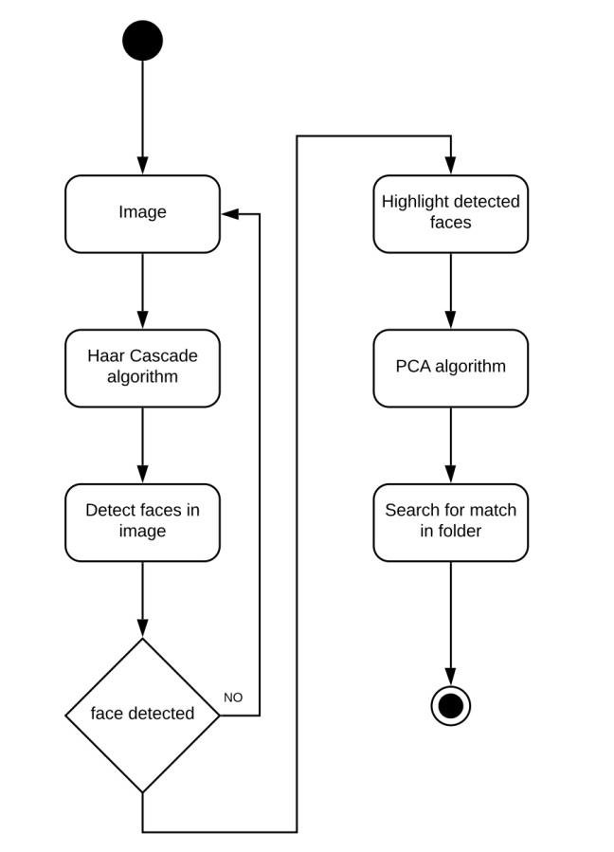
FLOWCHART

Slide 16
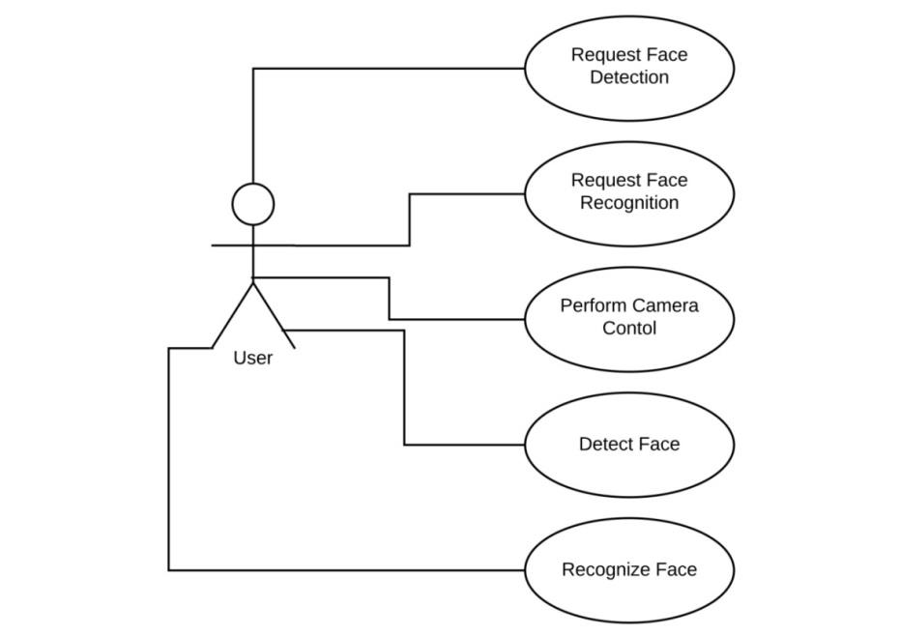
USE CASE MODEL

Slide 17
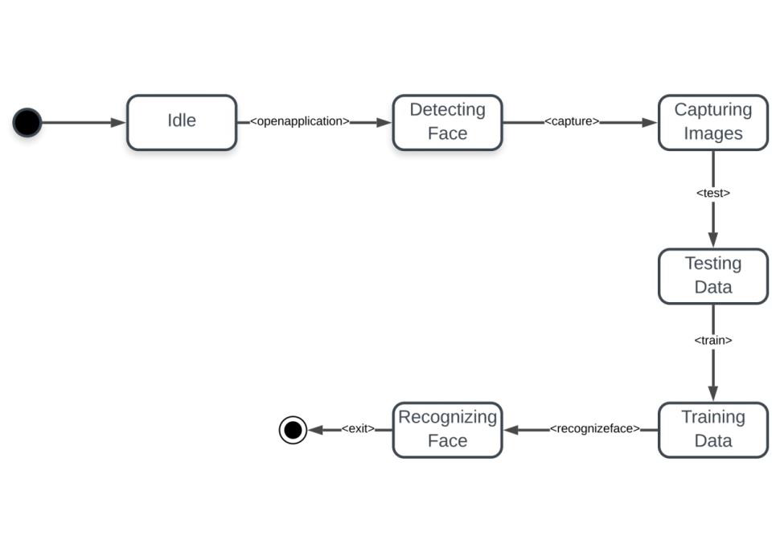
STATE CHART
STATE CHART

Slide 18
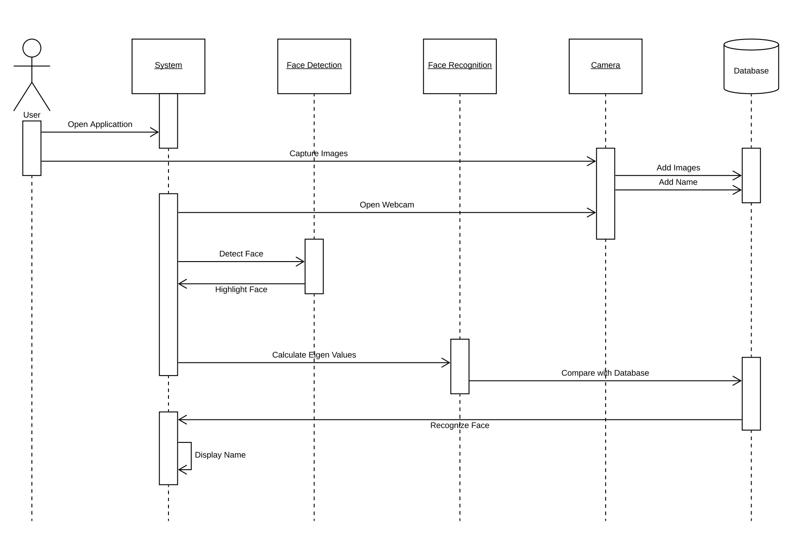
STATE CHART
SEQUENCE DIAGRAM

Slide 19
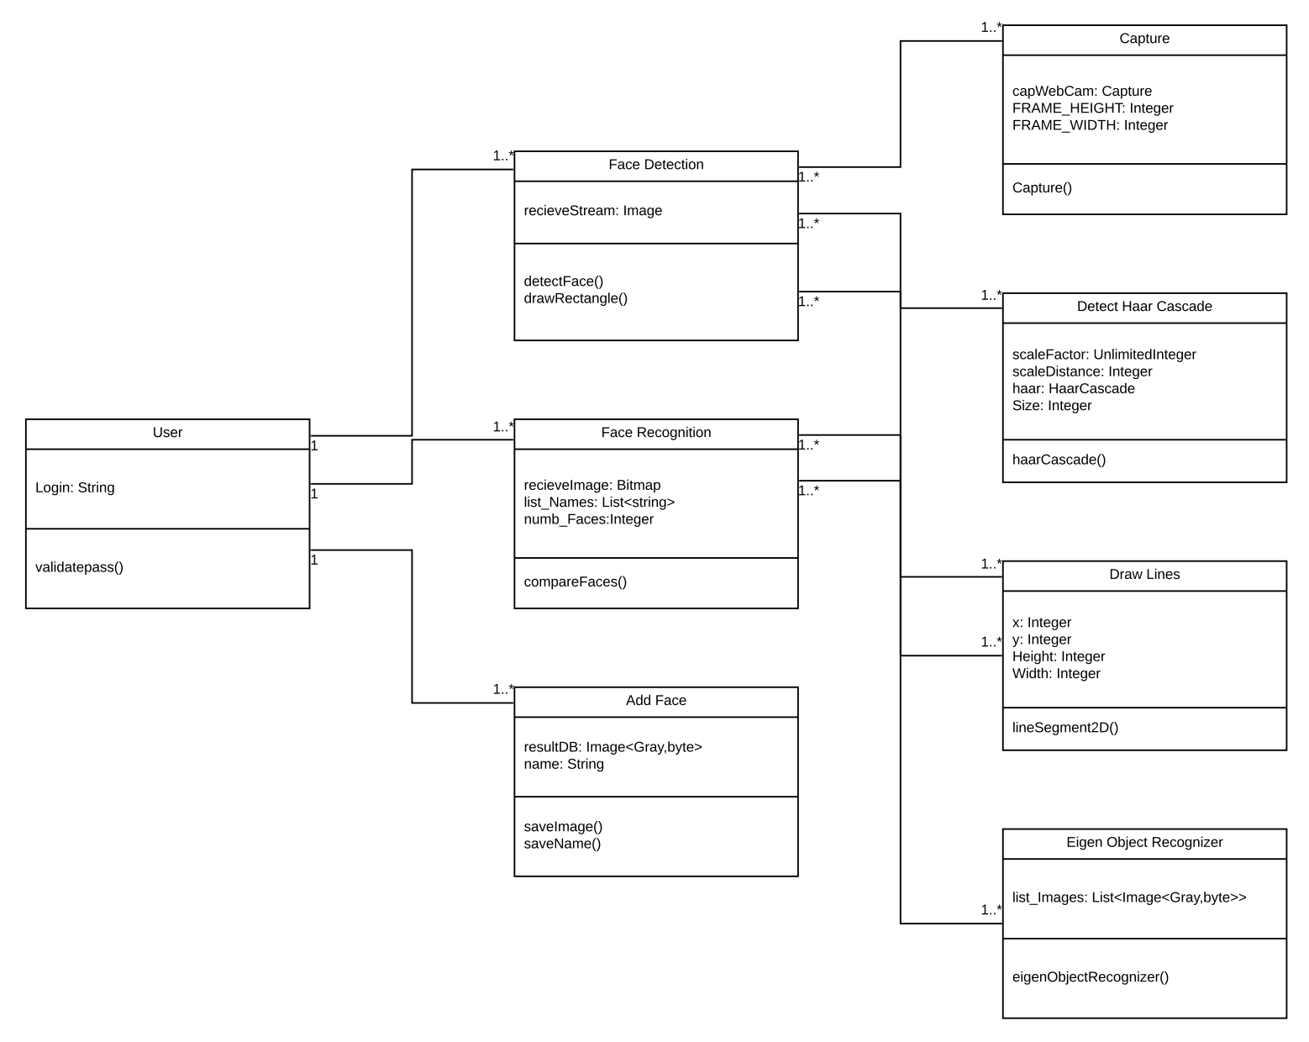
CLASS DIAGRAM

Slide 20
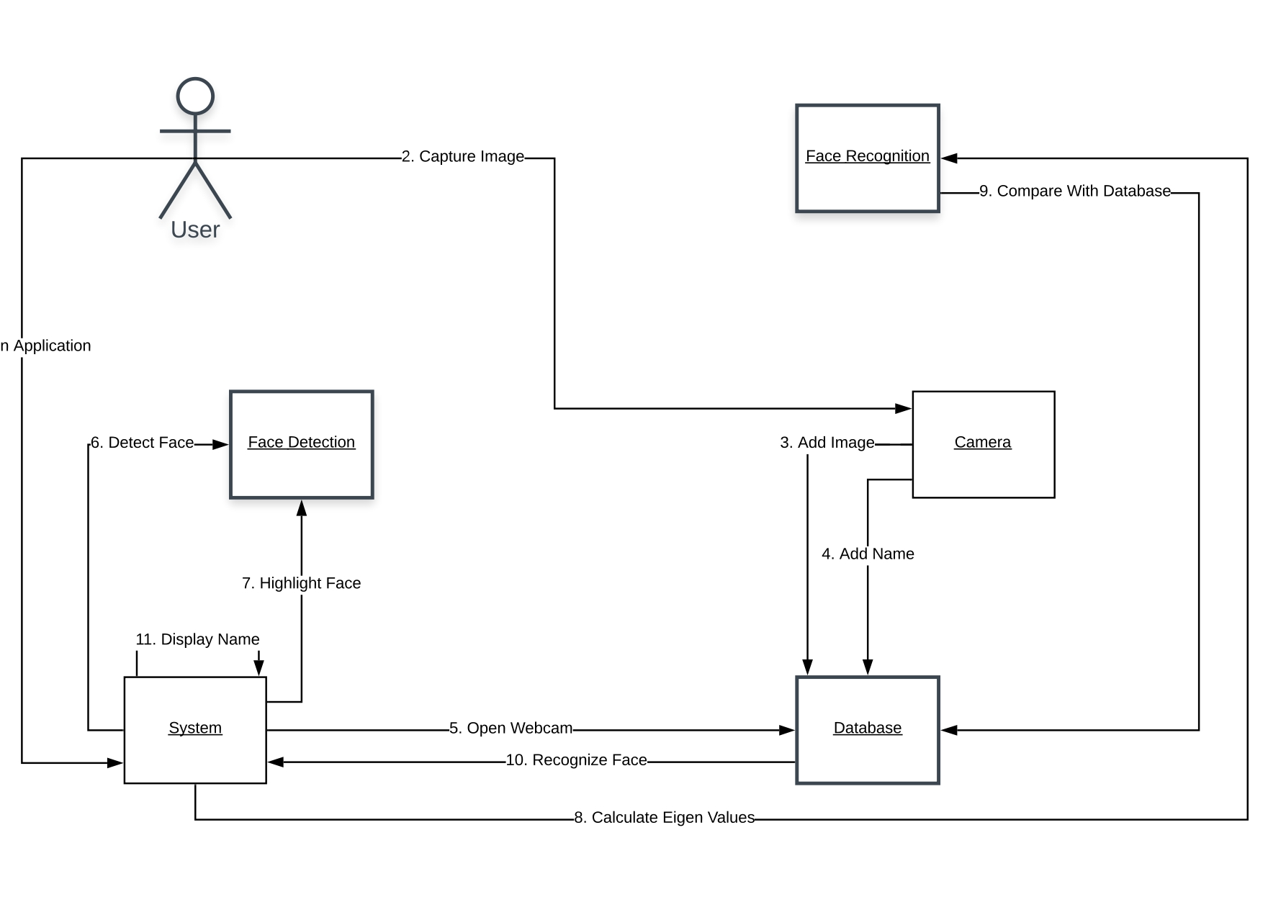
STATE CHART
COLLABORATION DIAGRAM

Slide 21
APPLICATIONS
CAN BE USED TO UNLOCK PHONES.
CAN BE USED TO FIND MISSING CHILDREN AND VICTIMS OF HUMAN TRAFFICKING.
DETECT CRIMINALS IN CCTV CAMERAS TO PREVENT THREAT.
ALL THESE APPLICATIONS ALONG WITH A LOT OF ADVANCEMENTS CAN BE USED IN THE FUTURE.

Slide 22
REFERENCES
1] Takeo Kanade. Computer recognition of human faces, volume 47. Birkh¨auser Basel, 1977.
2] Lawrence Sirovich and Michael Kirby. Low-dimensional procedure for the characterization of human faces. Josa a, 4(3):519–524, 1987.
3] M. Turk and A. Pentland. Eigenfaces for recognition. Journal of Cognitive Neuroscience, 3(1):71–86, Jan 1991.
4] Dong chen He and Li Wang. Texture unit, texture spectrum, and texture analysis. IEEE Transactions on Geoscience and Remote Sensing, 28(4):509–512, Jul 1990.

Slide 23
THANK YOU

